Slide 1
Pass to Builder
Begin Building Vehicle
Style
Customer enters their specs
Power
Check Inventory Database if parts given by customer are available
Transmission
Interior Seat
Material
Customer
Exterior
Material
Director
Interior Cabin Materials
Features
Return Finished Car

Slide 2
Continue Building
Pass to Builder
Begin Building Vehicle
Compact
Hybrid V12
Manual Transmission
Bulletproof Steel Exterior
18 inch Alloy Wheels
15 inch Solid Disc Brakes
8 seats
Leather Seats
Real Rose Wood Trim
Real Rose Wood Trim is low on stock
Leather Seats are low on stock
Director
Customer enters their specs
Reorder Real Rose Wood Trim
Reorder Leather Seats
Finish the car
Notify customer that their part is low on stock and delay their delivery
Customer
Notify Customer that their vehicle is ready
Update Inventory
Return Finished Car

Slide 3
Continue Building
Pass to Builder
Begin Building Vehicle
Customer enters their specs
Fullsize SUV
Hybrid V12
CVT Transmission
Steel Exterior
24 inch Alloy Wheels
20 inch Solid Disc Brakes
11 seats
Nappa Leather Seats
Titanium Trim
Director
Update Inventory
(Decrement inventory based on how many items are needed for construction
Finish the car
Customer
Notify Customer that their vehicle is ready
Return Finished Car

Slide 4
Customer
Orders
Car
CustomerName
PhoneNumber
EmailAddress
Home Address
Order Details
Engine
CustomerName
Type of Car
Materials
ETD (Estimated Delivery)
StyleOfCar
Gasoline
Electric
Hybrid
Exterior
Interior
V4
V6
V8
V12
Material
Color
Lights
Color
BulletProof
Interior
Materials
Transmission
Wood
Plastic
Fabric
Leather
Manual
Automatic
CVT

Slide 5
static DatabaseInstance()
getInstance()
static uniqueInstance()
Return dataBaseInstance()
Subject
notifyAll(string, string, map<string, int>
Observer
virtual void update(string, map<string,int>
NotifyCustomerObserver
update(string, map<string,int>
InventoryObserver
update(string, map<string,int>
PurchaseObserver
update(string, map<string,int>
CarBuilderObserver
update(string, map<string,int>

Slide 6
Director
buildCar()
buildEngine()
buildTransmission()
buildExterior()
buildInterior()
Builder
buildCar()
ConcreteCarBuilder
buildEngine()
buildTransmission()
buildExterior()
buildInterior()
Director
return finished Car

Slide 7
Work Breakdown Structure
Car Construction
2. Builder builds car and monitors inventory
3. Customer will be notified if their car is delayed, in construction, or ready to pickup
1. Customer enters specs
1. Style of car
2. Power train
Check inventory database and monitor stock of parts
1. Gas
V4
V6
Notify customer that their particular part is out of stock and will have to be reordered
V8
V12
2. Electric
3. Transmission
4. Exterior Material
5. Wheels
6. Brakes
7. NumSeats
8. Seats
9. Interior Material

Slide 8
Work Breakdown Structure
Car Construction
1.1
Initiation
1.2
Planning
1.3
Execution
1.4
Closeout of Project
Create scope
Design the system
Document overall project
Evaluation
Determine system requirements
Determine who are all part of the project
Discuss lessons learned
Project Proposal
Begin coding
Upload files and records of project
Project approved
Debug issues found in code
Approval on Project
User Training
Go live

Slide 9
Sequence diagram
Database uses Singleton to create one instance and reuse it if an instance already exists.
Set status of order to delayed and push back delivery date
Director
Builder
Singleton Database
Observer/Builder
Observer
Customer
User enters
their specs
Builder gets the specs
Insert specs into customerCarOrderInfo database
Check inventory database to see if there are enough parts for the customer’s car
Notify Customer if their vehicle is near completion, or ready to take delivery
Tell customer that their part isn’t available, and that their delivery date has been pushed back
Return Finished Car to customer

Slide 10
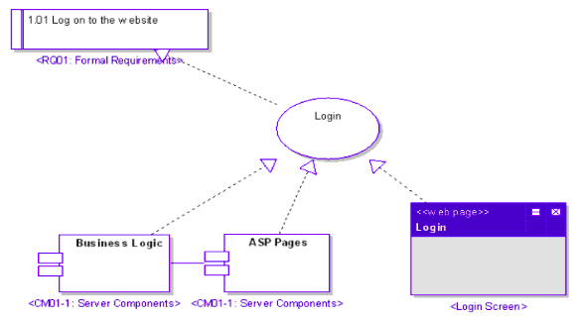
Customer enters their specs
Style
Powertrain
Transmission
Exterior Material
Wheels
Brakes
Number of seats
Seat Material
Interior Cabin Material
Customer
Return Finished Car

Slide 11
CarBuilder
(used for building and getting the components for the vehicle)
CarDirector
(used for taking in specs from customer)
Database Singleton
Main program
InventoryObserver
(for monitoring inventory in database)
Iterator (for iterating through the vectors (used in query() function for database, and map for the itemName and quantity
PurchaseObserver
(for ensuring that a product that is low on stock is reordered)

Slide 12
Inventory
Purchase
Inventory
Tracking
PurchaseOrder
Tracking

